Slide 1
Accurate Activation on Wrist Raise for Smartwatches
Sheng Shen ECE@UIUC

Slide 2

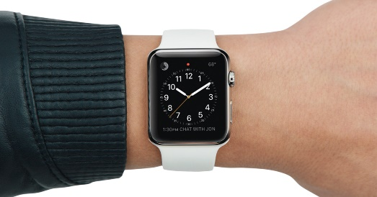
Smartwatch: More than a watch
Time

Slide 3
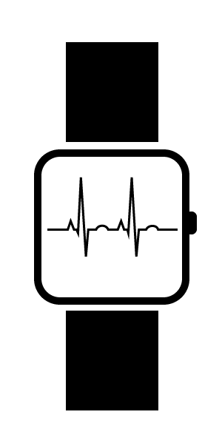
Smartwatch: More than a watch
Time
Sensors Accelerometer, Gyroscope
Compass
Heartrate

Slide 4

Smartwatch: More than a watch
Time
Sensors Accelerometer, Gyroscope
Compass
Heartrate
Wireless Technology Bluetooth, Wi-Fi, GPS

Slide 5
Smartwatch: More than a watch
Functionality + Interaction

Slide 6
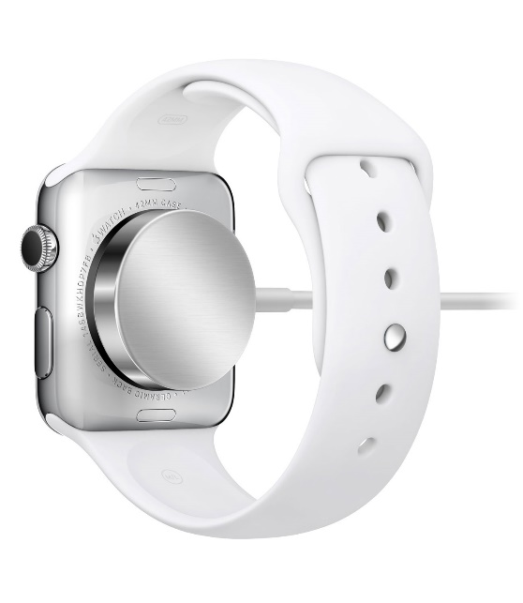

Battery: Always a pain!

Slide 7
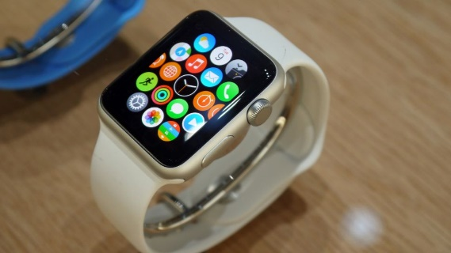
Battery: Always a pain!
Biggest Battery Drainer: Screen

Slide 8
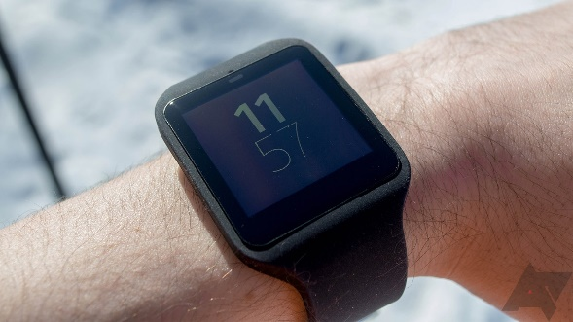
Solutions
Keep screen dim all the time
Require a ‘tapping’ to start operating ☹

Slide 9
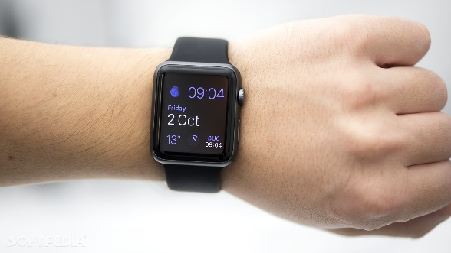
Solutions
Keep screen dim all the time
Opportunistically turn screen on
Require a ‘tapping’ to start operating ☹
Detect wrist raise motion and activate ☺

Slide 10
Problem with current Activation on wrist raise
False positives
Delay
Not adaptive
Black box

Slide 11
Problem with current Activation on wrist raise
False positives
Delay
Not adaptive
Black box
Build our own technique!

Slide 12
Things to keep in mind…
Need to run in the background continuously! Use energy-saving sensors – accelerometer, gyroscope, etc.

Slide 13
Things to keep in mind…
Need to run in the background continuously! Use energy-saving sensors – accelerometer, gyroscope, etc.
Users will not tolerate any delay! Detection must be real-time

Slide 14
Things to keep in mind…
Need to run in the background continuously! Use energy-saving sensors – accelerometer, gyroscope, etc.
Users will not tolerate any delay! Detection must be real-time
Need to run on watch… Algorithms must be lightweight and fast

Slide 15
Demo

Slide 16
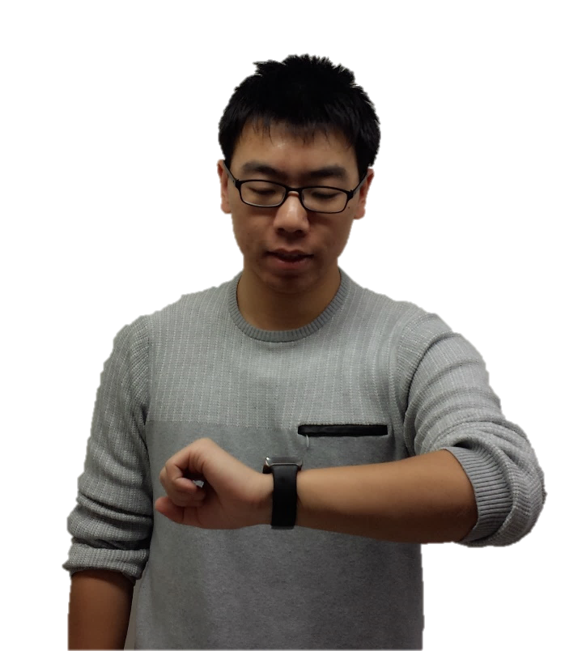

Area of interest When we raise wrist…
The watch faces human eyes.

Slide 17
Area of interest When we raise wrist…
The watch faces human eyes. How to detect if watch is in AOI?

Slide 18

Motion sensors: a deeper look
Y
Accelerometer Measures acceleration along X, Y and Z (includes gravity)
Gyroscope Measures rotational speed around X, Y and Z
X
Z
Z is pointing out of watch face

Slide 19
Area of interest Gravity should tell us that!
Y
Assume the watch is stationary…
Some gravity along –Z
Some gravity along –Y
Others along +/- X, but should not too much
X
Z
Gravity
Z is pointing out of watch face

Slide 20
AOI detection using accelerometer
Arm on body left side
Wrist raised

Slide 21
AOI detection using accelerometer
Arm on body left side
Wrist raised
For any time window with length W
Min(Accel Y) > th1
Min(Accel Z) > 0
Min(Accel X) > th2
Max(Accel X) < th3

Slide 22
AOI information is not sufficient…
Reach for a book on the shelf vs. Raise wrist to see time while walking

Slide 23
AOI information is not sufficient…
Reach for a book on the shelf vs. Raise wrist to see time while walking
Acceleration tells us both these two are in AOI, but only the second one is correct

Slide 24
AOI information is not sufficient…
Reach for a book on the shelf vs. Raise wrist to see time while walking
Acceleration tells us both these two are in AOI, but only the second one is correct
Opportunity: watch orientation tends to be stable for a while when we look at it

Slide 25
AOI stability detection using gyroscope
Left: Reach books
Right: Look at time while walking

Slide 26
AOI stability detection using gyroscope
Left: Reach books
Right: Look at time while walking
Abs(Gyro X, Y, Z) < th4

Slide 27
Further details
How to choose parameters? - Collected data from 3 different users - Derived thresholds that has highest classification rate in distinguishing intentional wrist raise from other motions
How to adapt to different users? - We have implicit ground truth data for wrist raise for each user - Adapt the thresholds over time

Slide 28
Future work
Test on more users and report accuracy
Need user feedback to evaluate latency
Report energy usage (e.g. with different sampling rates)

Slide 29
Thanks!
sshen19@Illinois.edu

